Slide 1
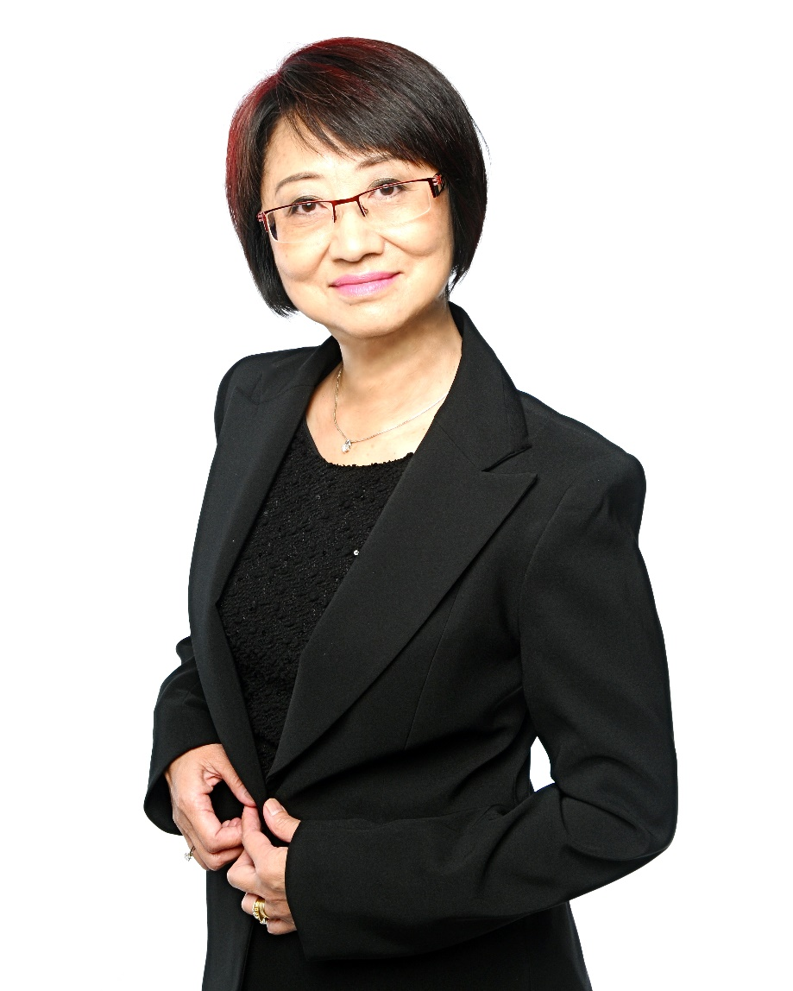
Doreen Ling
National Supervising Coordinator
Certified Trainer
Speaker Bureau Category 2 Member
Sydney Local Coordinator
Australian Leadership Council Member
Multiple Challenge winners
Top Organisation Builder Award
Master UFO
Shopping Annuity Master member

Slide 2
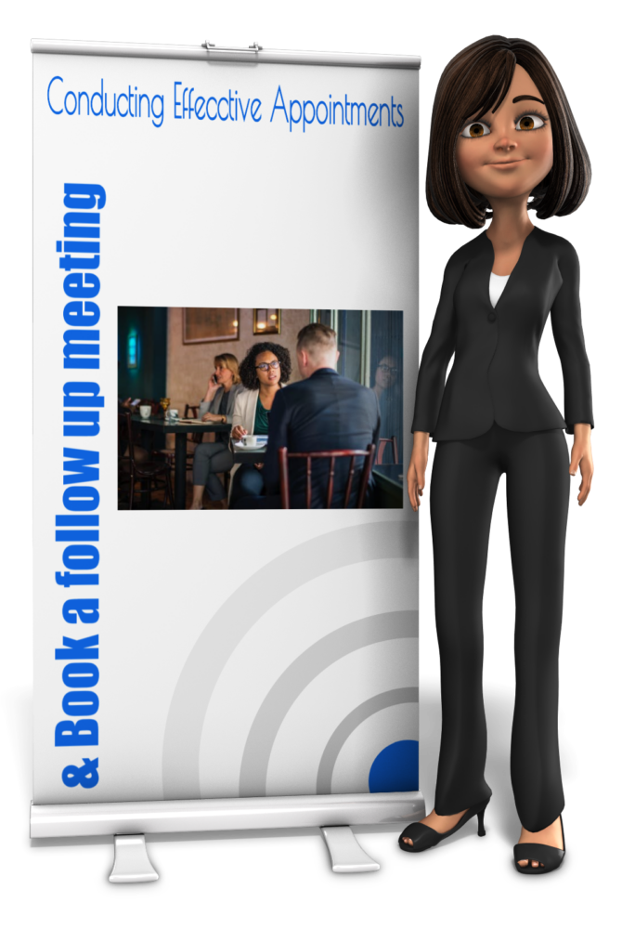
Conducting effective appointments
&
book a follow up meeting

Slide 3
Preparation
Preparation starts before you make the invitation to the appointment

Slide 4
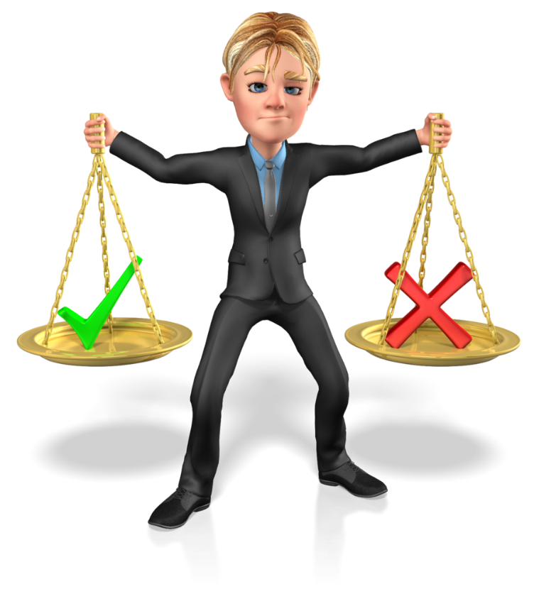
Who should you invite?
people from your warm list
Not people from your cold list
people you already have built some relationship
Not people you just met new
people you have not qualified
people you already qualified

Slide 5
Invite to the appointment correctly
Objective of appointment
Time duration
Clear instruction on where to meet
Appointment is firm
Reminder the day before

Slide 6
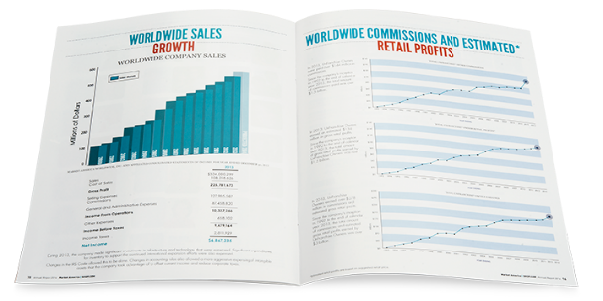
Home Shopping List
Flip Chart
Bring your tools
Product Catalog
Annual Report

Slide 7
People judge you in seconds

Slide 9
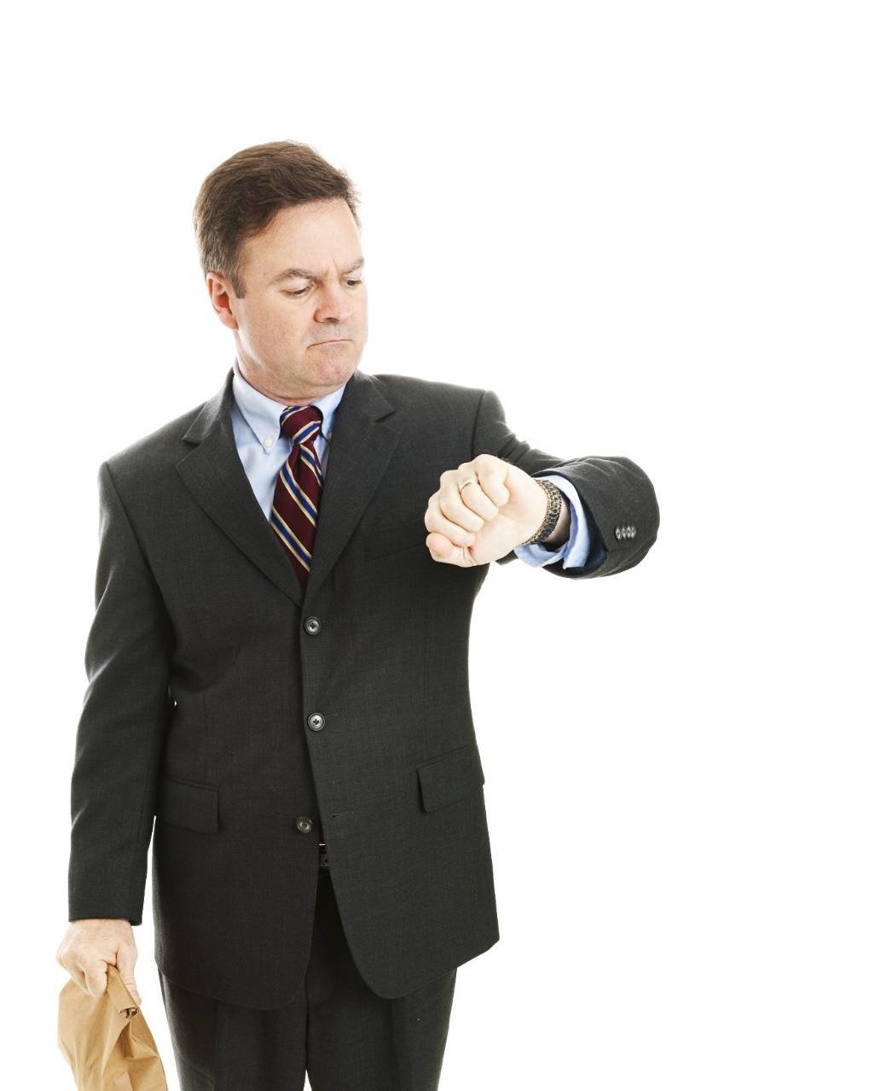
Be on time

Slide 10
Check out the venue

Slide 11
Create a relaxed atmosphere
Pay attention to seating arrangement
Introduce to others who are present
Build bridges

Slide 12
Build Rapport
Without rapport, people will not hear a word you say

Slide 13
Rapport gives
Total responsiveness
Instant connection

Slide 14
Rapport is created by a feeling of commonality
People like people who are like themselves
or who they like to be

Slide 15
Build rapport through Mirroring
How they shake hands
How they speak – Tone, tempo, volume
Body posture
Facial expression
Eye contact

Slide 16
Rapport affects the subconscious mind

Slide 17
After you build rapport
You are connected, you have the trust, then you can ask questions

Slide 18
You MUST master the skill of asking questions

Slide 19
90% listening & asking questions
10% making comments
Notes:
19
19

Slide 20
Question #1
How much time do you have?

Slide 21
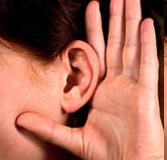
Do not rush through this.
Important clues here
Question #2
Ask questions about
Family
Occupation
Recreation
Money
Find the pain points

Slide 22
Question #3
You mentioned that you are interested to know about the business I am doing.
Do you know much about shop.com?
Give a quick web portal tour

Slide 23
Are you interested in learning how we are compensated?
Question #4

Slide 24
Question #5
If you were to invest some time in a part time venture over the next 1-2 years, what sort of financial return would you expect to receive for your efforts?

Slide 25
You MUST know how to show the plan

Slide 26
Do mini closes
Do you agree everyone is spending everyday?
Do you like to get paid for your spending & other people’s spending?
Do you agree it is a good business?
Income keeps coming even when you stop working. That is residual income. Do you like that?

Slide 28
Bring it back to 3 simple steps
Use products for yourself
- Build Points to earn commissions
2. Develop some customers who buy products.
- Make profit and build points to earn commissions.
3. Introduce the business to two other people
- start building 2 organisations.

Slide 29
Start of Closing Questions
What do you like best from what you see?
Ability to replace your income?
Ability to earn residual income
Convert spending into earning?
Based on what we have talked about and your goals, what is your interest in getting more information?

Slide 30
Be Prepared for Questions and Objections! It is going to Happen!! Relax!!! Have some fun!
Notes:
30
30

Slide 31
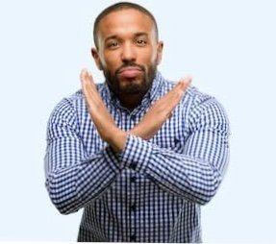
They May Say No
Thank them politely
Leave the door open
Don’t burn bridges
No just mean timing is not right at the moment
Don’t take it personally
Sign them up as a preferred customer

Slide 32
They maybe confused
It is okay. Nobody understands everything the first time.
“You have to see it a few times to appreciate it.
Take the Flip chart. Go through it and list down questions you may have.
Let us book in a time so I can answer your questions
Book in a follow up appointment now

Slide 33
Let me think about it
“Great, let’s get back together in a couple of days to answer your questions”
Let’s schedule the appointment now.

Slide 34
Or
“Great, one of the best ways to evaluate our business is to attend one of our trainings”
Sell a ticket to next event

Slide 35
I have to talk with my spouse
“That’s a great idea, would it be possible for the three of us to get together?”
Let’s schedule the appointment now.

Slide 36
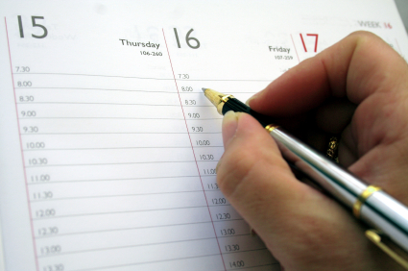
Know your schedule

Slide 37
Recap
To conduct effective appointment
Preparation
Build Rapport & ask questions
Quick web portal tour
Show plan
Answer questions and objections
Book follow up appointment

Slide 38
Relax & Enjoy the process

